Slide 1

Understanding Angular
Angular is a powerful open-source web application framework developed by Google. It plays a crucial role in full stack development by providing a robust and opinionated approach to building dynamic and scalable front-end applications.
Name : Shivendra
Roll : 22H51A0557
CSE-D

Slide 2

What is Angular?
1
TypeScript-based
2
Component-based
Angular is built on TypeScript, a superset of JavaScript that adds optional static typing.
Angular's architecture is centered around reusable UI components that encapsulate logic, templ and styles.
3
Dependency Injection
Angular's Dependency Injection system allows for modular and testable application design.

Slide 3
Angular's Role in Full Stack Development
Front-end Powerhouse
Seamless Integration
Productivity Boost
Angular provides a robust and scalable front-end framework for building complex web applications.
Angular integrates well with various backend technologies, enabling a cohesive full stack solution.
Angular's tooling and best practices boost developer productivity and code maintainability.

Slide 4
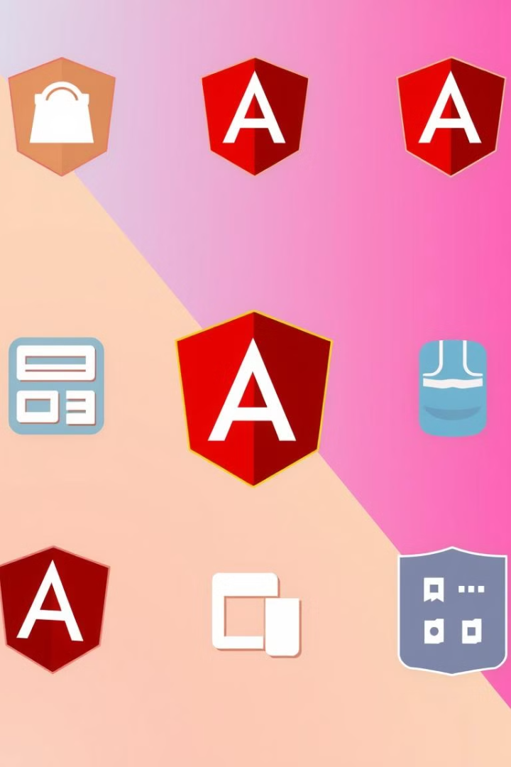
Key Angular Features and Capabilities
Routing
Data Binding
Angular's powerful routing system enables complex navigation and single-page application (SPA) functionality.
Angular's two-way data binding simplifies the synchronization of data between the model and view.
Forms
Dependency Injection
Angular's reactive and template-driven forms provide a robust and flexible approach to handling user input.
Angular's built-in Dependency Injection system promotes modular and testable application design.

Slide 5




Integrating Angular with Backend Technologies
Backend Integration
Data Management
Cloud Deployment
Angular seamlessly integrates with various backend technologies, such as REST APIs and GraphQL.
Angular works well with both SQL and NoSQL databases, allowing for efficient data handling.
Angular applications can be easily deployed to cloud platforms, ensuring scalability and availability.

Slide 6

Best Practices for Angular Development
1
Modular Design
2
TypeScript Adoption
Organize code into logical modules to promote reusability and maintainability.
Leverage TypeScript's static typing and tooling to catch errors early and improve code quality.
3
Reactive Programming
4
Unit Testing
Utilize RxJS and the reactive programming paradigm for asynchronous data handling.
Implement comprehensive unit tests to ensure the reliability of individual components.

Slide 7
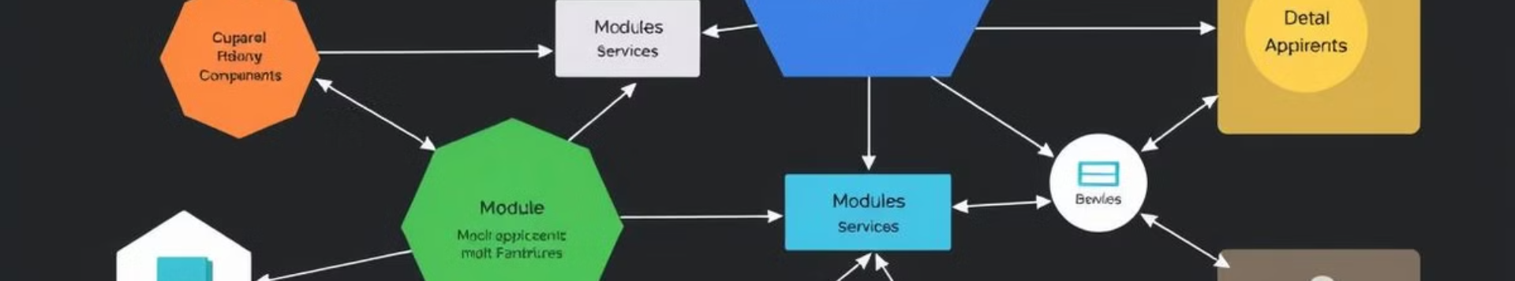



Scaling Angular Applications
Modular Structure
Lazy Loading
State Management
Organize the application into feature modules to improve code organization and maintainability.
Implement lazy loading to optimize performance by only loading necessary modules on demand.
Utilize a state management solution like NgRx to manage the application's global state effectively.

Slide 8


